Slide 1
WEBCAST
Practical Open Source Intelligence
OSINT for Everyone:
Understanding Risks and Protecting Your Data
© 2018 Spotlight Infosec LLC and Josh Huff | All Rights Reserved

Slide 2
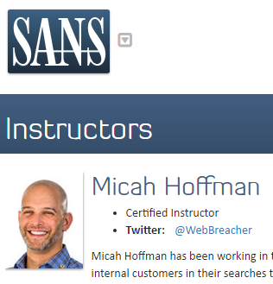
Micah Hoffman, @WebBreacher
https://webbreacher.com
Certified SANS Instructor
Booz Allen Hamilton
Author of SEC487 OSINT Course
Cyber Security Community Cheerleader

Slide 3
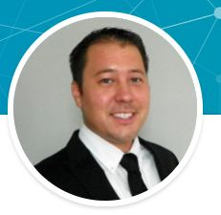
Josh Huff, @Baywolf88
https://www.learnallthethings.net
Digital Forensics Analyst
Private Investigator
Information Security Conference Speaker
ColaSec Meetup Co-organizer
Blogger

Slide 4
What is OSINT?
OSINT is Open Source INTelligence
Information in the public domain or accessible from public sources
Media such as audio, video and pictures
Text from documents, articles and blogs
Maps and geolocation of data
Social Media
Sometimes called SOCMINT for SOCial Media INTelligence

Slide 5
Data is Just Data Until Analyzed
Anyone can Google a topic
How many times have you seen someone look on page 2 or 3 of a Google search result page?
The collection, organization and analysis of that data is important (and there may be a LOT of data)
The “intelligence” portion of OSINT is the key

Slide 6
The OSINT Cycle
Requirements gathering
Retrieving data
Analyzing information
Pivoting to a new perspective or Reporting analysis
Require-ments
Retrieval
Analysis
Pivoting & Reporting

Slide 7
Examples of real-world "pivots"

Slide 8
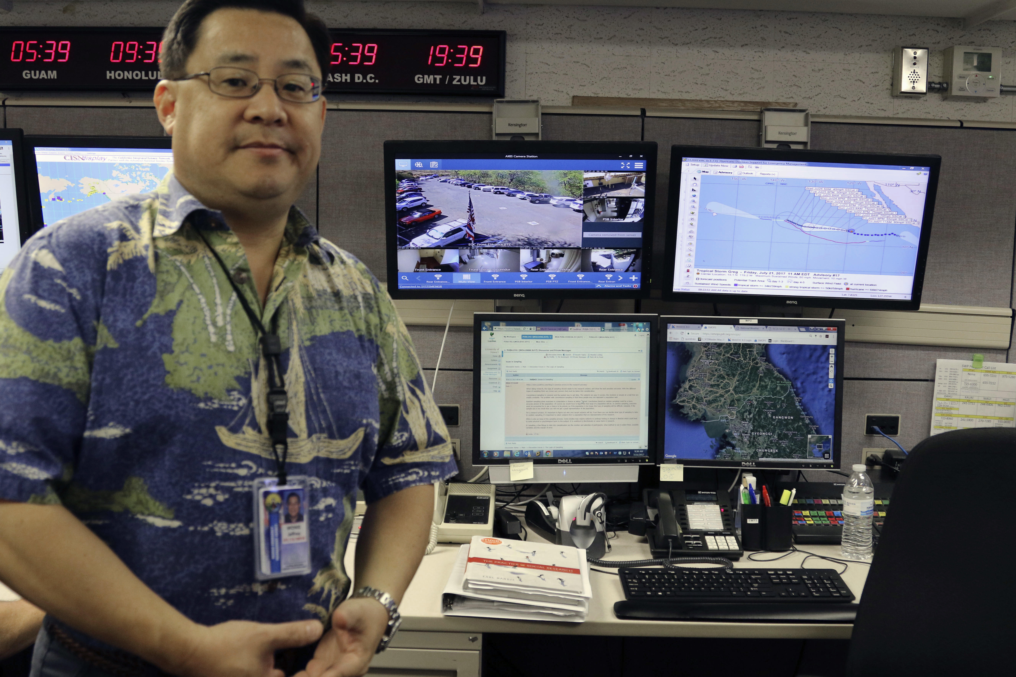
What Do You See?
Hawaii Emergency Management Agency

Slide 9
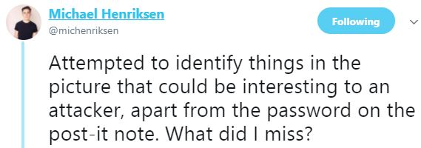
Twitter Goes to Work
Camera Placement
Phone Numbers
Software Usage
Badge
Bluetooth Headset… etc.
https://twitter.com/michenriksen/status/953616091368099840

Slide 10
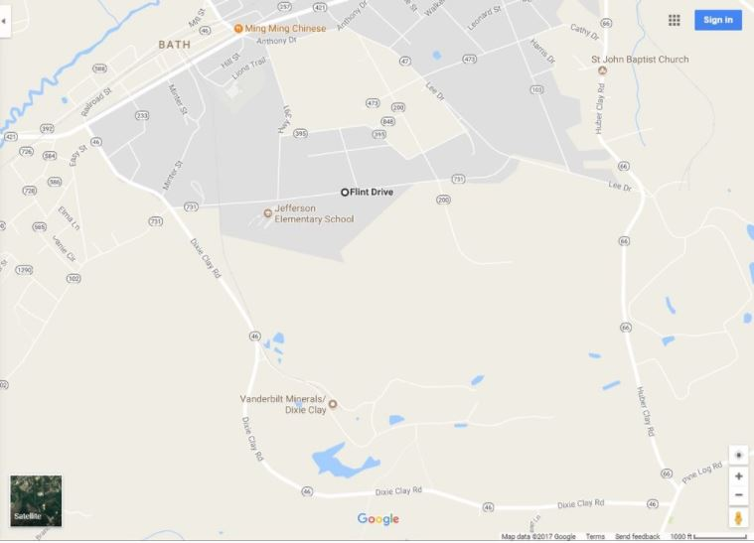
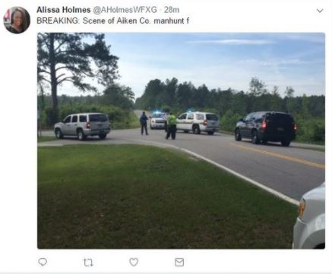
Pivoting: Geographic Location
Manhunt in progress reported via Twitter
News reports the county but not exact location

Slide 11
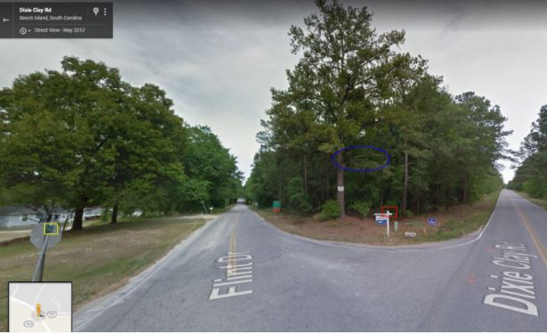
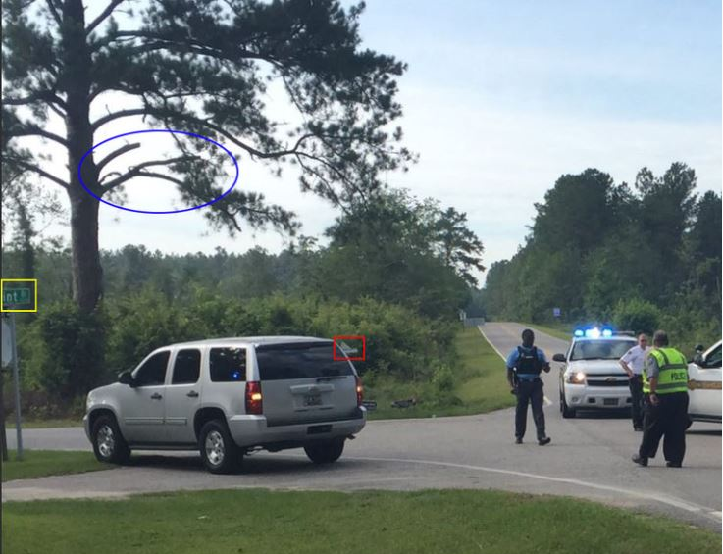
Pivoting: Geographic Location
Google Maps Street View
Image from Twitter
Intersection of Flint Drive and Dixie Clay Rd

Slide 12
How do people use OSINT?

Slide 13
Parents, Spouses and Partners Use OSINT
Parents may research
Who is my child’s care giver?
What does my child’s OSINT persona look like?
Research neighbors for sexual predators/convicts
Remote location reconnaissance for vacations
In a relationship or want to be?
Who is this person I want to date?
Is my partner cheating?

Slide 14

Businesses Use OSINT
To find competitive intelligence on their rivals
In the hiring/interview processes
Looking for malicious insiders
Finding “missing” employees
Mergers and acquisitions
Investigations for fraud
Legal support (Intellectual Property)

Slide 15

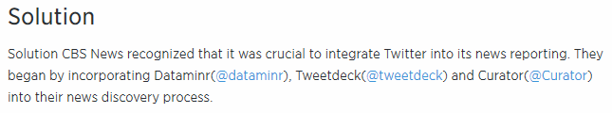
Media Entities Use OSINT
Instant reporting of events
“Eye witness accounts”
Researching stories
Fact-checking
The downside is that this is under-validated content
Lacks analysis
Lacks context

Slide 16

Law Enforcement Agencies Use OSINT
Finding criminals and their networks
Posting about suspects on social media (asking for the public’s help)
“Stupid Criminals”
Still and video surveillance of police and public

Slide 17
Intelligence Agencies Use OSINT
Finding and monitoring terrorist networks
Attribution of events
Cyber – Indicators of Compromise (IOCs)
Real-world
Movement of resources (troops, military equipment)
Targeting for attacks (cyber and real-world)
Recruitment of assets

Slide 18
OSINT for “Bad”
Cyber Attack
Phishing, vishing, pretexting, identity theft
Objective details, computer systems, network addresses, software
Theft
Extortion
Assault
Kidnapping
Organized Crime
Terrorism
Stalking, harassment, bullying, criminal mischief

Slide 19
Online Data You Have Control Over

Slide 20

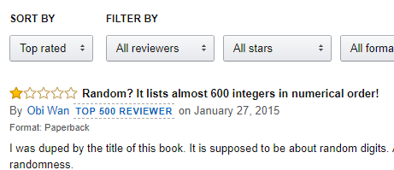
What You Share Online
Social Media photos, text, and video
Reviews, opinions and comments
Connections between our various accounts
Fitness data - Exercise activities and health information
Geolocation
Notes:
https://pixel.nymag.com/imgs/daily/selectall/2017/08/17/17-facebook-anon.nocrop.w710.h2147483647.jpg

Slide 21
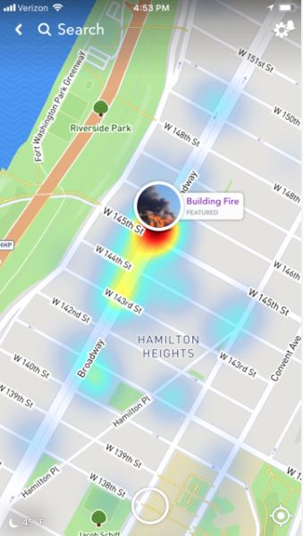
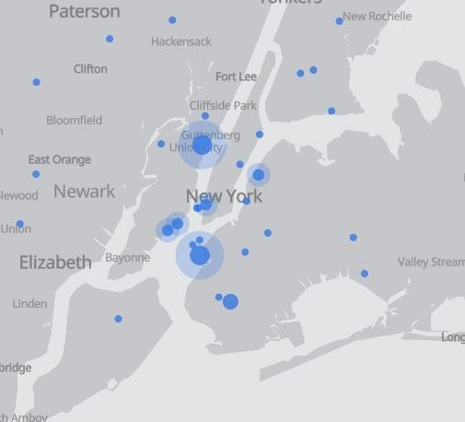
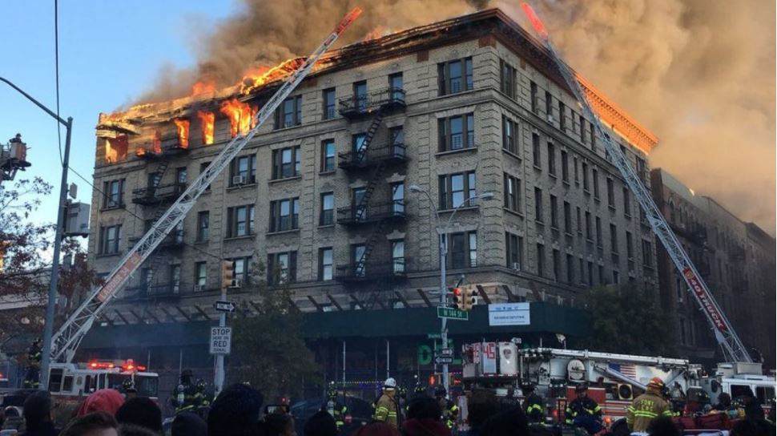
Broadcasting your Location: During Emergency Situations
Snap Map & Facebook Live Map
Notes:
This type of data is potentially useful to the user and the viewer. Broadcast to friends that you are OK, and let others around you know of a dangerous situation

Slide 22
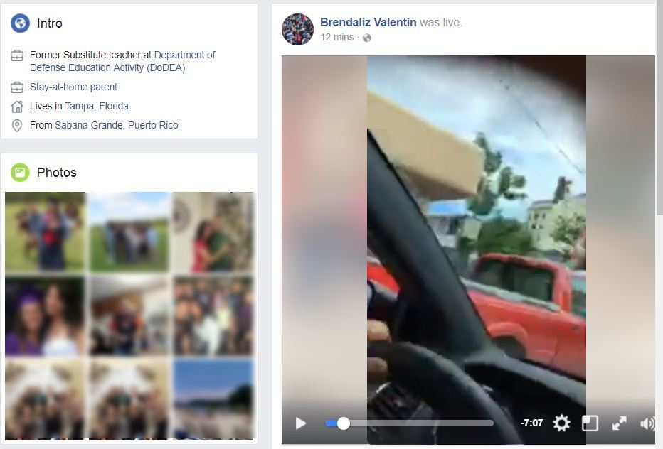
Broadcasting your Location: To Entertain
Facebook live video:
User driving
and talking while using cell phone
Notes:
Facebook live data (your location comes from your ‘About’ section of your profile. This person appears on the map to be broadcasting near Tampa Florida

Slide 23
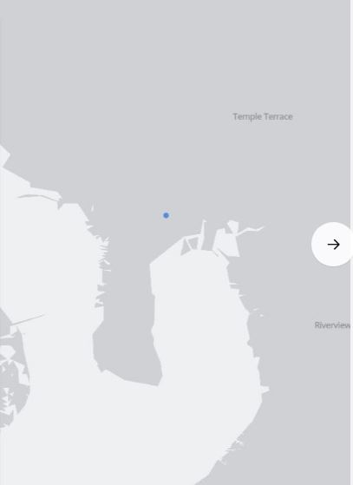
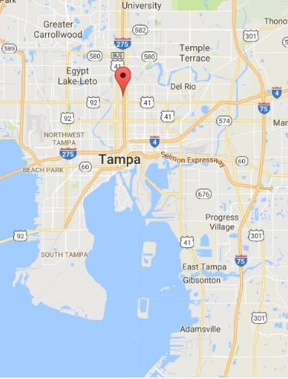
Broadcasting your Location: To Entertain
Facebook live video:
We can see the broadcaster's reported location on Facebook's map
Location data comes from the "About" section of profile
Notes:
Facebook live data (your location comes from your ‘About’ section of your profile. This person appears on the map to be broadcasting near Tampa Florida

Slide 24
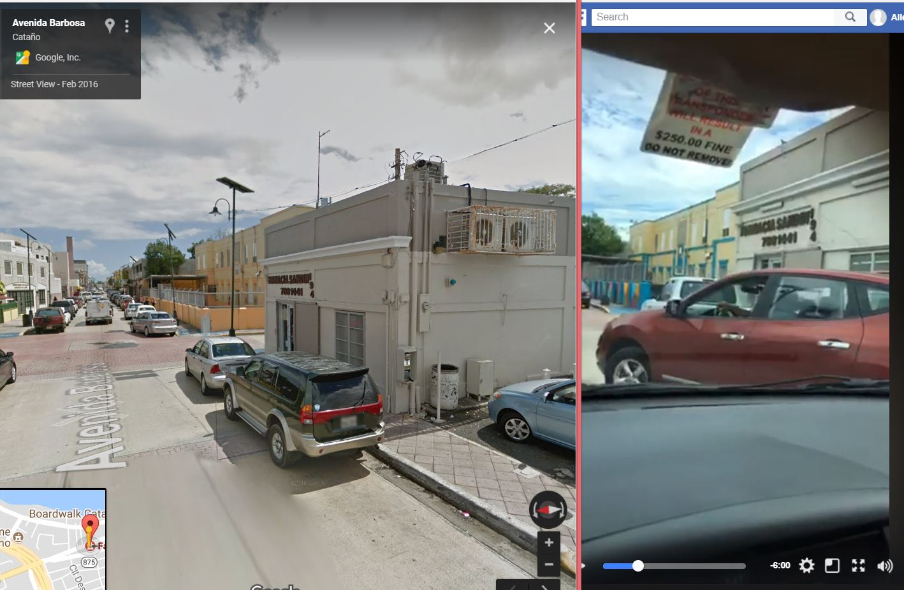
Broadcasting your Location: To Entertain
Using cues in the audio (word "Cataño" and from images in the video, we can find the actual place she is transmitting from
Google Maps Street View
FB Live Image
Notes:
But in listening to the video, she says the word Catano at one point and drives by something I can use to Geolocate. To a Farmacia in Puerto Rico

Slide 25
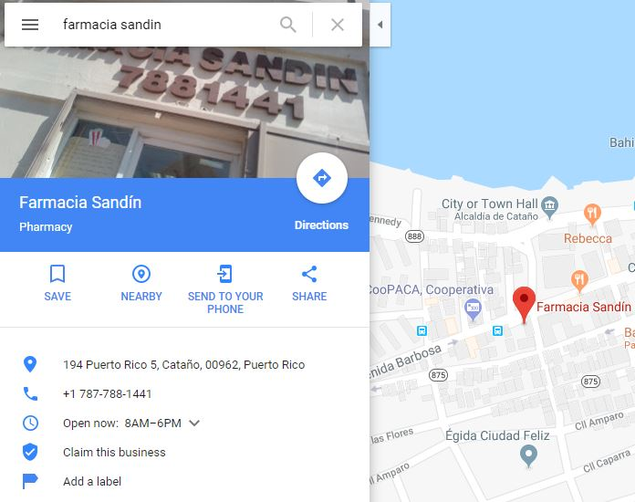
Broadcasting your Location: To Entertain
Video location is not
Tampa, Florida but
Cataño, Puerto Rico
Notes:
But in listening to the video, she says the word Catano at one point and drives by something I can use to Geolocate. To a Farmacia in Puerto Rico

Slide 26

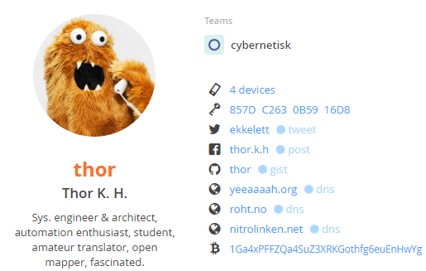
Tying Your Accounts Together
https://about.me
https://keybase.io

Slide 27
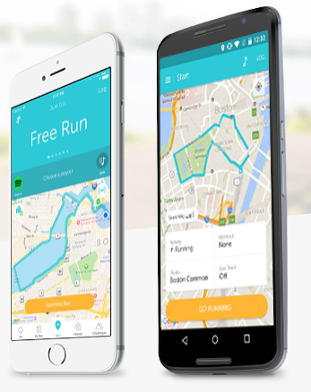
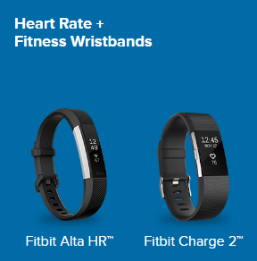
Fitness Data as OSINT
OSINT Opportunities
Friends (Social)
Repeated events/Schedule
Locations of "places"
Where do you start/stop your exercises?
Where do you exercise?
Privacy concerns
Trusting some company all of this

Slide 28
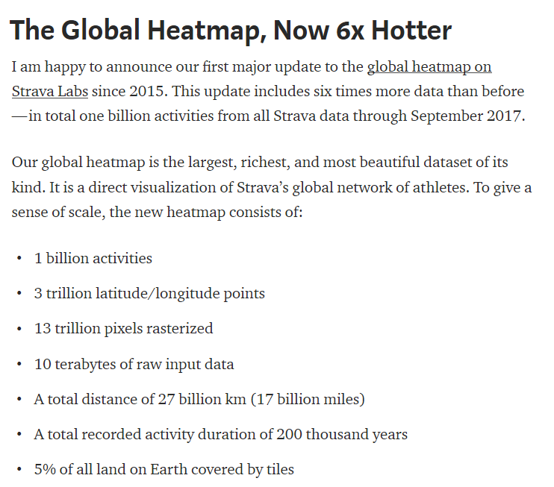
Strava's Activity Heatmap
Short URL: https://the.osint.ninja/2GqLueY
Long URL: https://medium.com/strava-engineering/the-global-heatmap-now-6x-hotter-23fc01d301de?_branch_match_id=486221495564653952

Slide 29
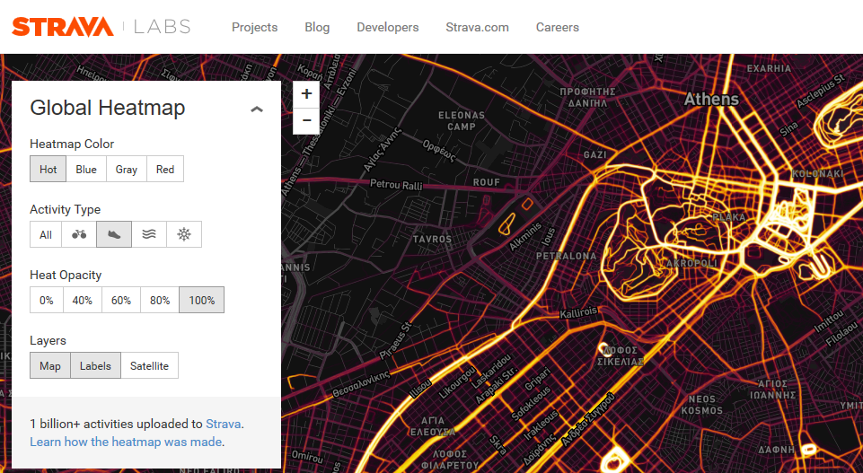
Strava Running Data in Athens, Greece
Short: https://the.osint.ninja/2DIHSHD
Long: https://labs.strava.com/heatmap/#13.66/23.74425/37.94626/hot/run

Slide 30
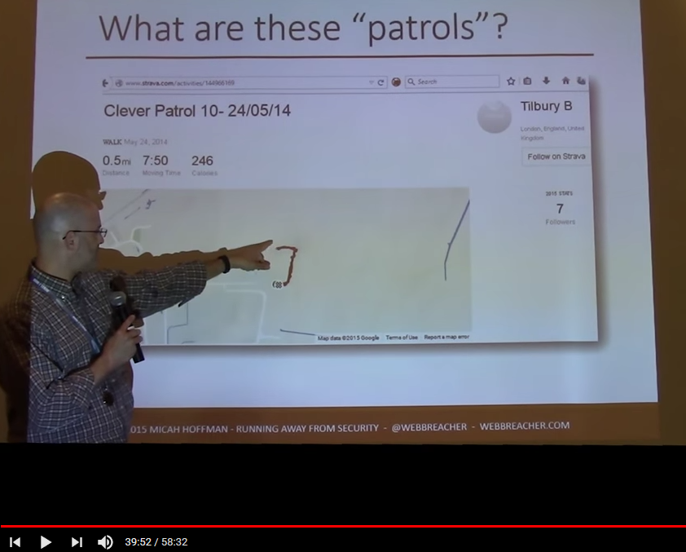
Strava Data
In 2014-15, Micah found some companies in the UK were using Strava to track where their security guards walked ("patrols")
BSidesDC 2015 video
https://youtu.be/4XED-r29_Iw?t=39m39s

Slide 31
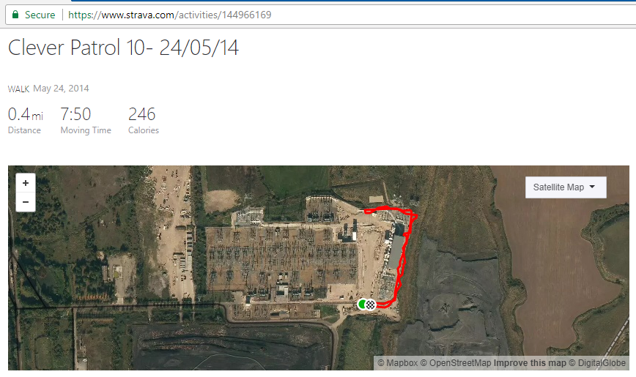
Revisit Strava Activity
https://www.strava.com/activities/144966169

Slide 32
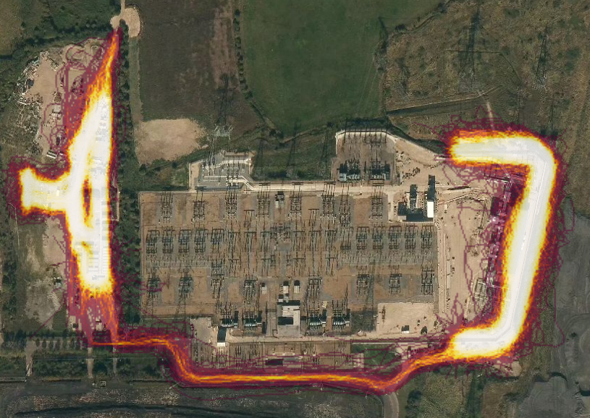
Strava Heatmap View of Tilbury Power Substation

Slide 33
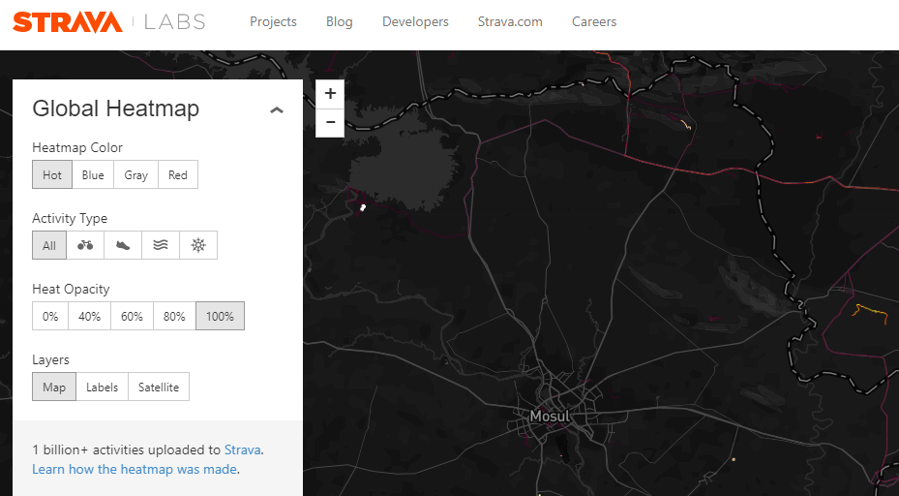
Bringing Light to the Dark in Mosul, Iraq

Slide 34
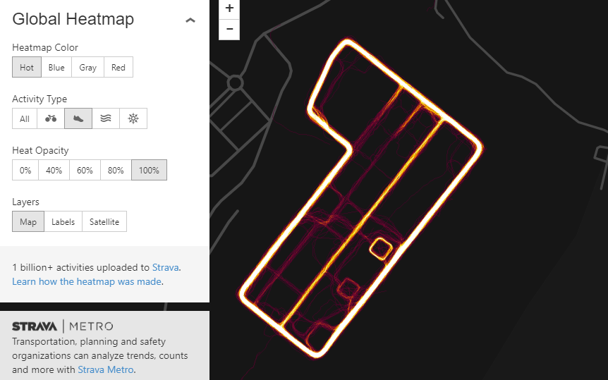
Digging into the Heatmap
https://labs.strava.com/heatmap/#16.00/42.84071/36.60545/hot/run

Slide 35
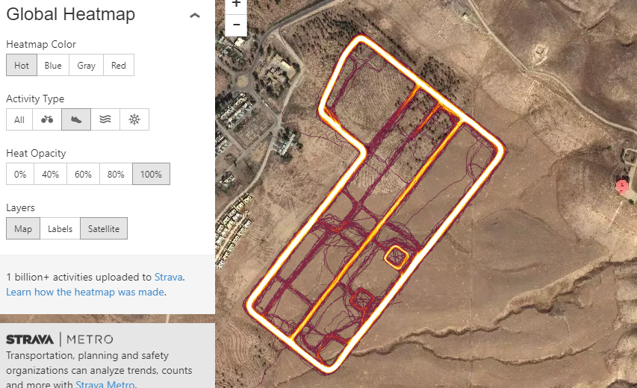
Satellite View of Heatmap
https://labs.strava.com/heatmap/#16.00/42.84071/36.60545/hot/run

Slide 36
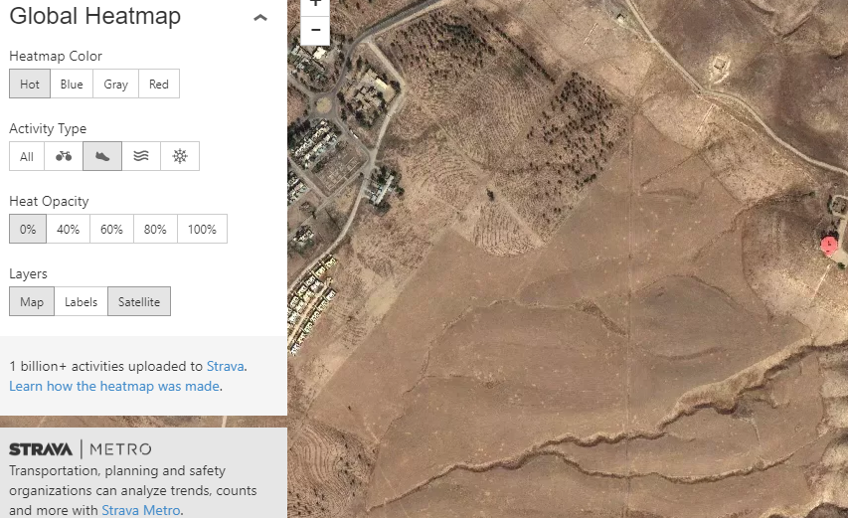
Satellite View of Area - What is missing?
https://labs.strava.com/heatmap/#16.00/42.84071/36.60545/hot/run

Slide 37
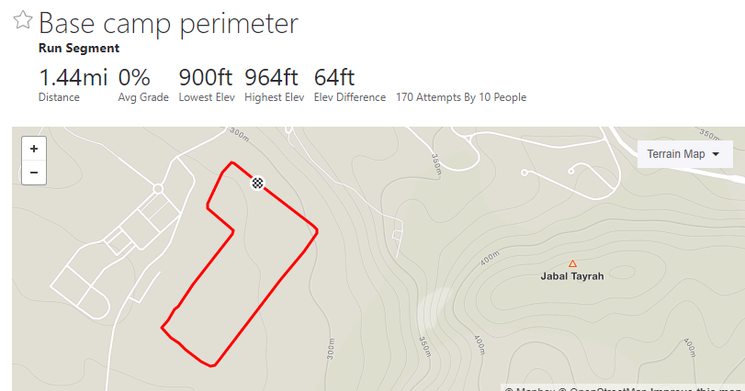
What is the Risk?
https://www.strava.com/segments/14986778

Slide 38
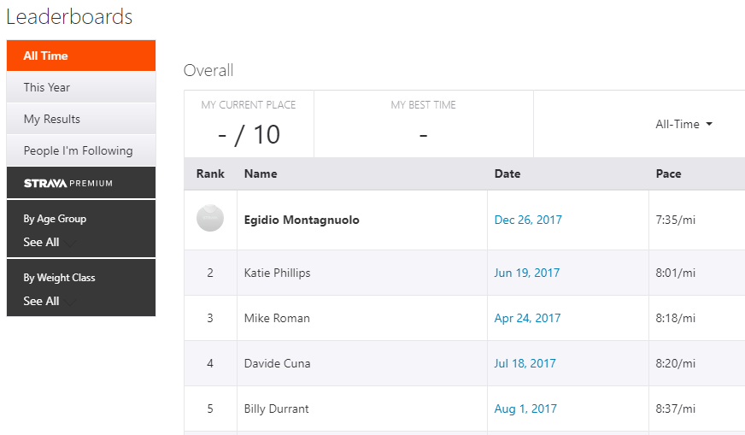
Finding Details on the Athletes

Slide 39
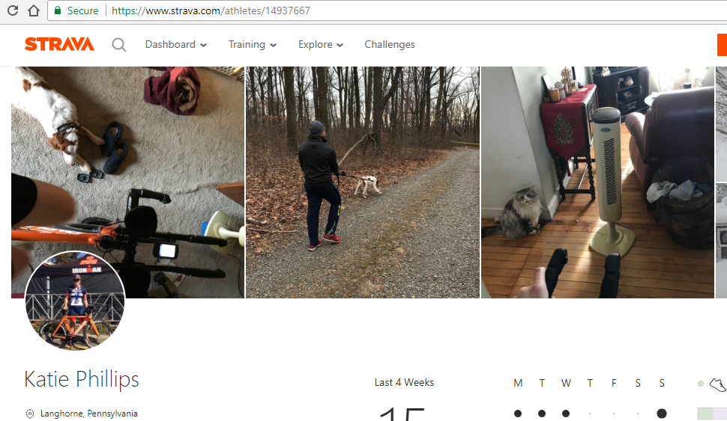
Athlete's Profile

Slide 40
Exercise Activities Summary
We can sometimes find:
Who performed the activities
Where they live/work
Who their friends are
What equipment they use
Pictures inside their homes
Repeated events/habits/routines
Sites can change their data model with "our" data

Slide 41
Online Data You Don't Have Control Over

Slide 42
Data Out of Our Control
Even if you don't use social media, others do:
You appear in a photo and facial recognition matches you (bystander)
Your friends might "tag" or confirm a person is you
Other OSINT locations:
Government data – judicial issues, registrations
Real estate info – taxes, who bought and when
Religious groups and hobby club newsletters
Life cycle events – births, deaths, marriages, divorces

Slide 43
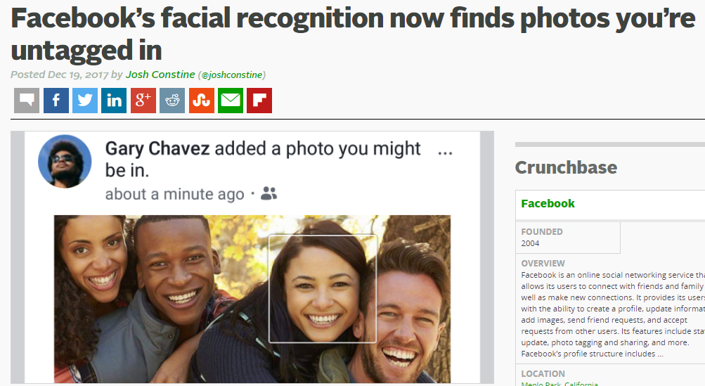
Facebook's Facial Recognition
Short: https://the.osint.ninja/2Gsrk4n
Long: https://techcrunch.com/2017/12/19/facebook-facial-recognition-photos/

Slide 44

Religious Newsletters
Excellent data in newsletters:
Names, Addresses, Phones, Emails
Who is sick
Who celebrated a life event and when
Photos
Upcoming events
Notes:
Image from https://www.pexels.com/photo/gold-mosque-during-sunset-161276/

Slide 45
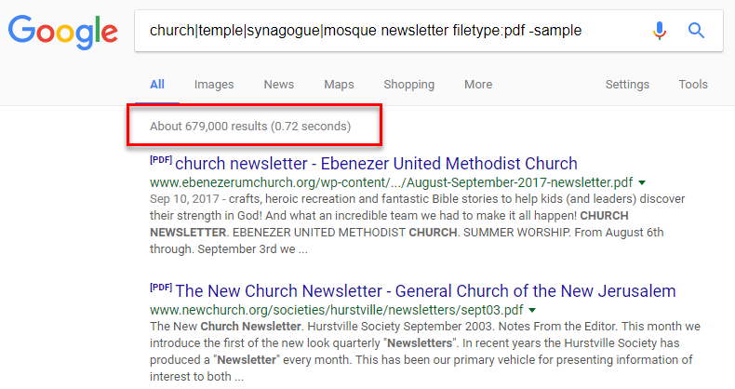
Google Knows About Newsletters

Slide 46
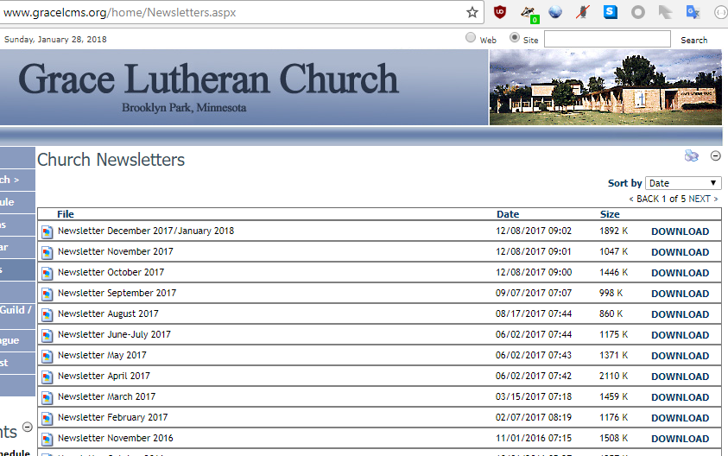
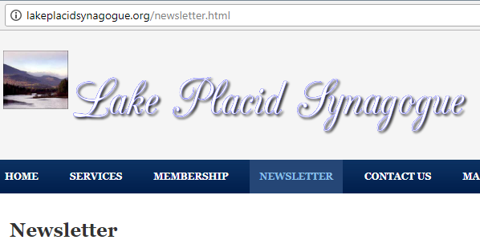
Years of Data (2010-Present)

Slide 47
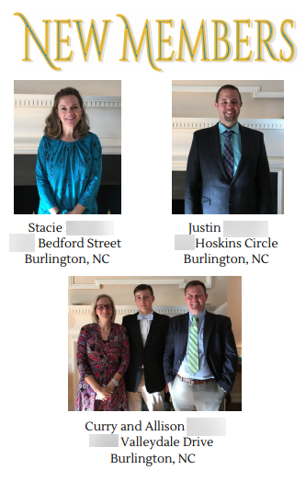
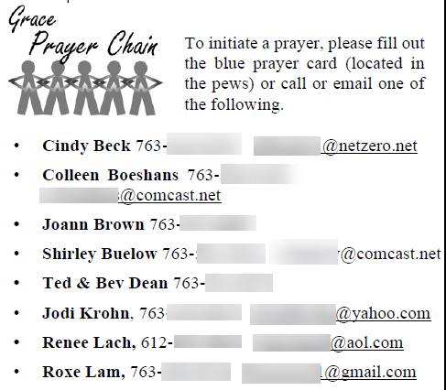
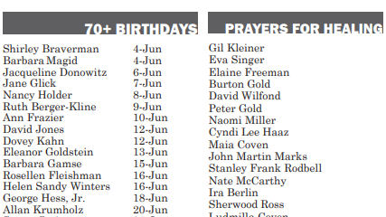
Example Content in Newsletters
Notes:
http://lakeplacidsynagogue.org/uploads/3/5/2/3/35236007/spring2014.pdf

Slide 48
Religious Newsletter Summary
We can sometimes find:
Names
Contact info (phone, address, email)
Relationships
Life events (births, deaths, sickness)

Slide 49
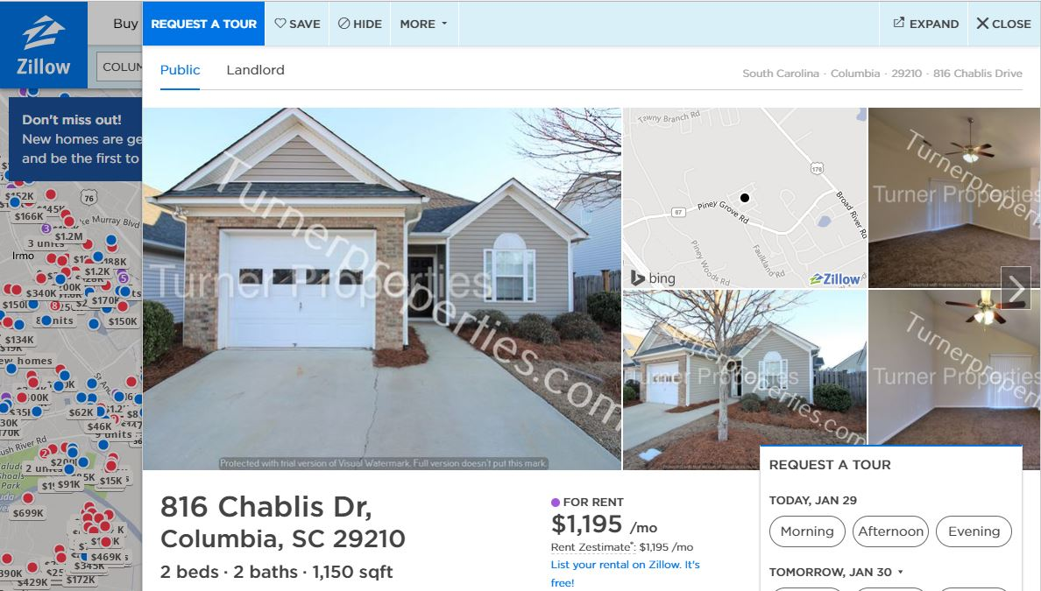
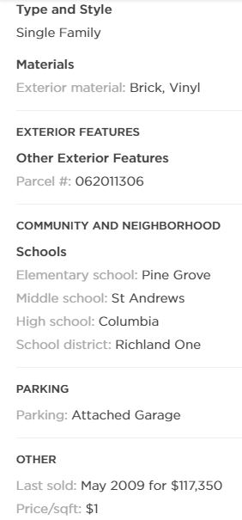
Real Estate: Property Information
Notes:
A rental property listing in South Carolina on Zillow.com. These sites are great for general information about the neighborhood and what school districts they fall into.

Slide 50
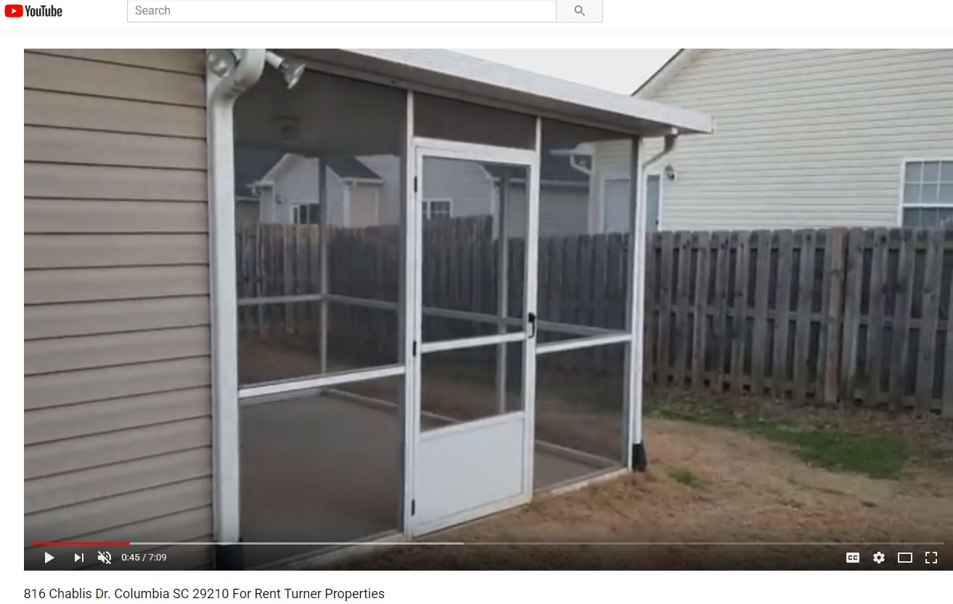
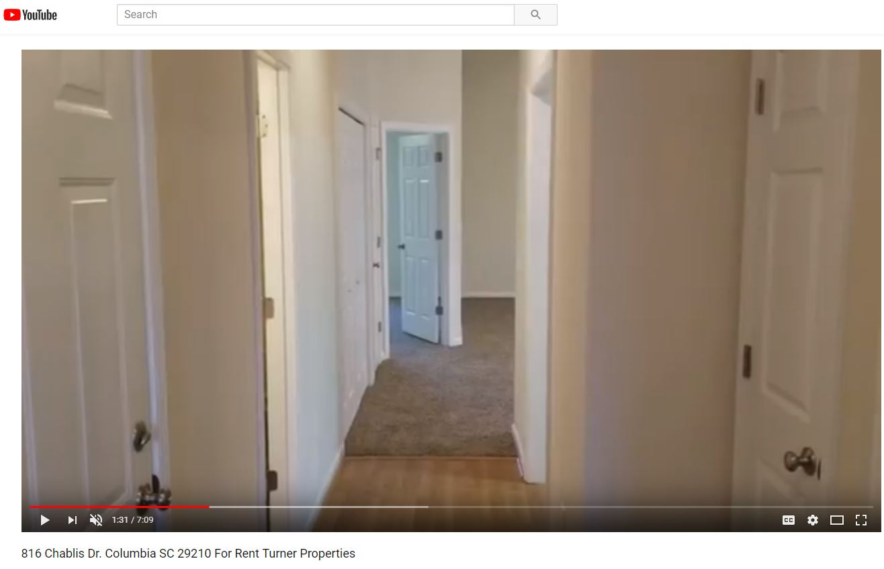
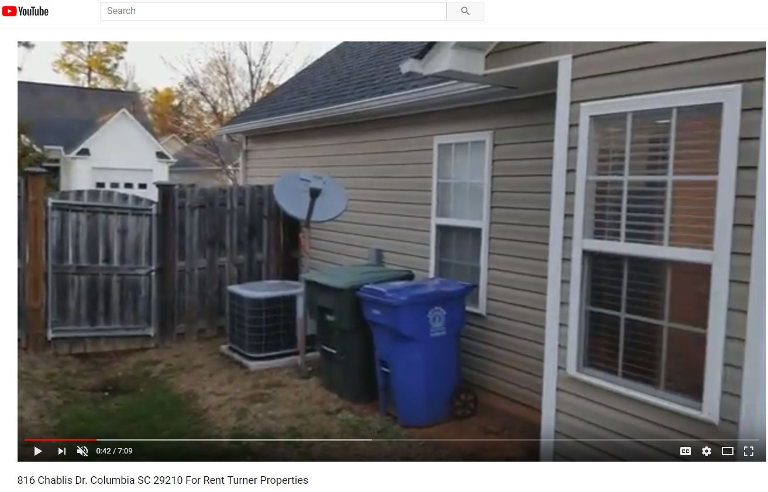
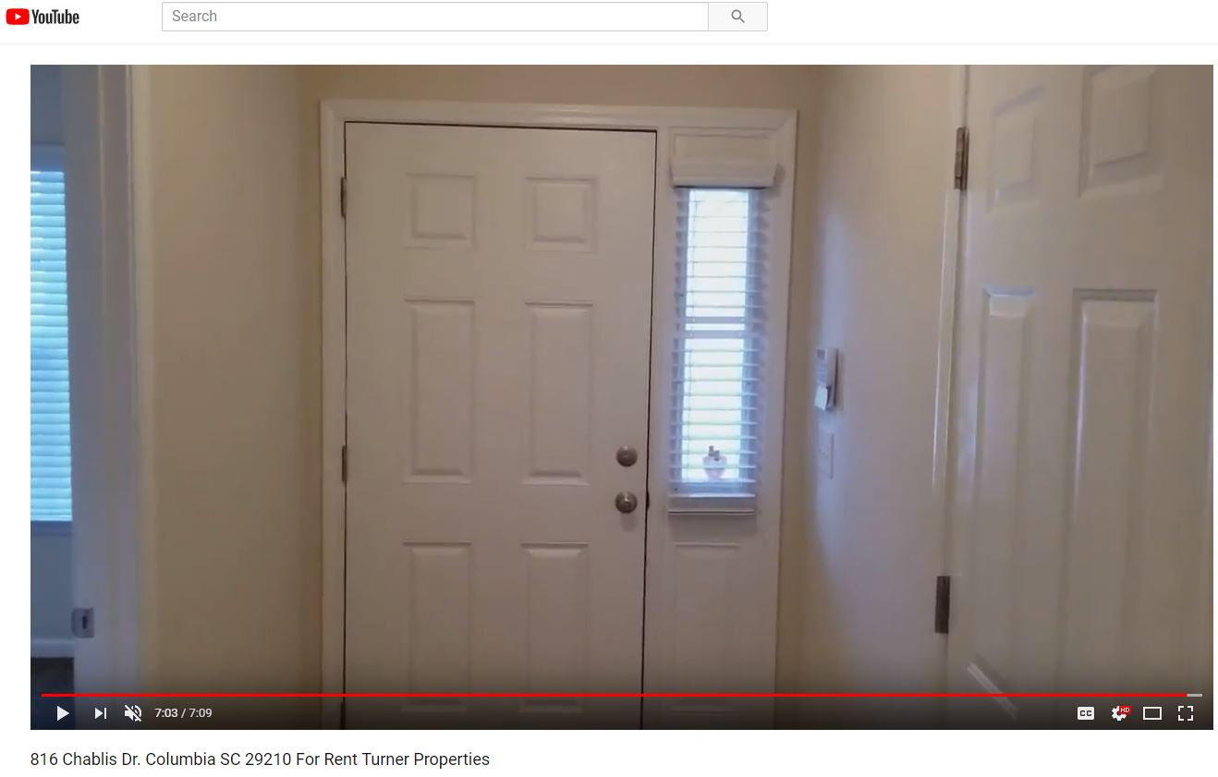
Real Estate: Interior Images and Videos
https://www.youtube.com/watch?v=FODat-casII
Notes:
This rental company has a youtube video featuring a walk through of the outside and inside of the house (every room).

Slide 51
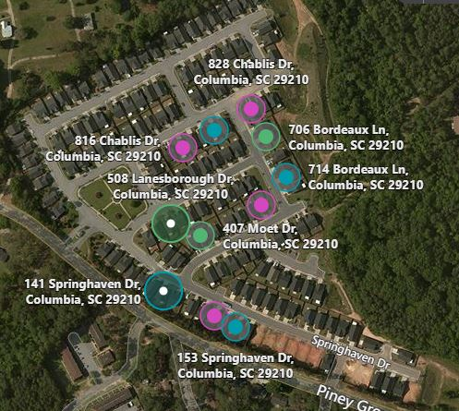
Real Estate: Homes with Similar Floor Plans
https://www.bing.com/maps
Notes:
Bing maps shows 11 houses with the same footprint/floorplan as the one in the rental video walkthrough
So even if I’m careful not to post things about my residence on social media, if I happen to live in a similar floorplan as the rental…

Slide 52
Interesting OSINT

Slide 53




Interesting OSINT: What else?
OSINT Tracking Sites
Trains
Planes
Boats
Satellites
And much more
We have access to many interesting resources that make OSINT fun!

Slide 54
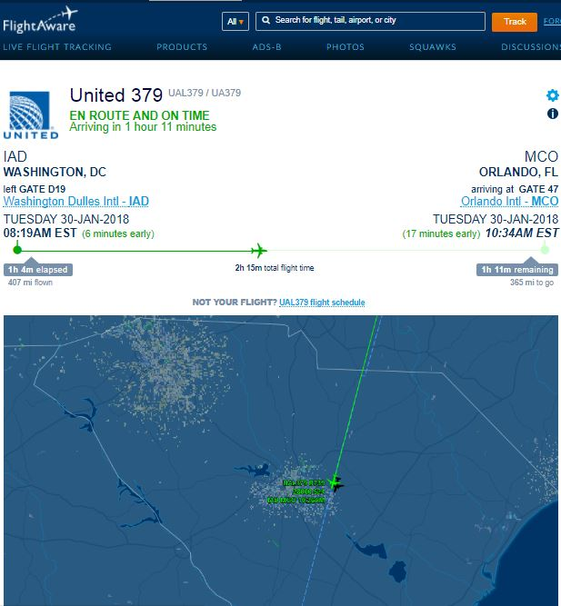
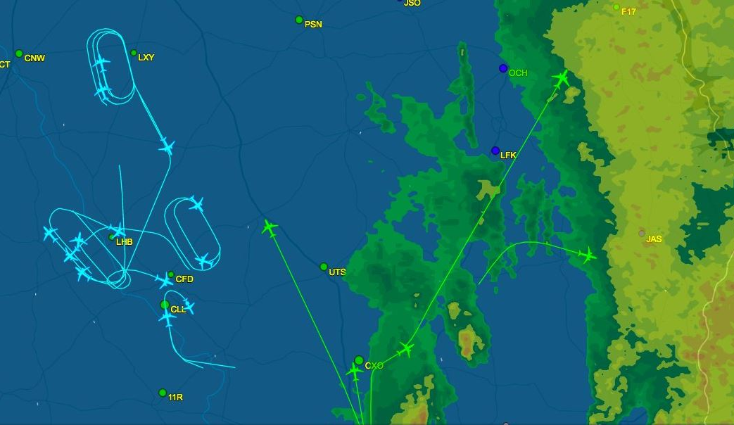
Interesting OSINT: Tracking Airplanes
Notes:
Awesome for keeping tabs on if your flight is on schedule. Interesting patterns during weather and other disruption events

Slide 55
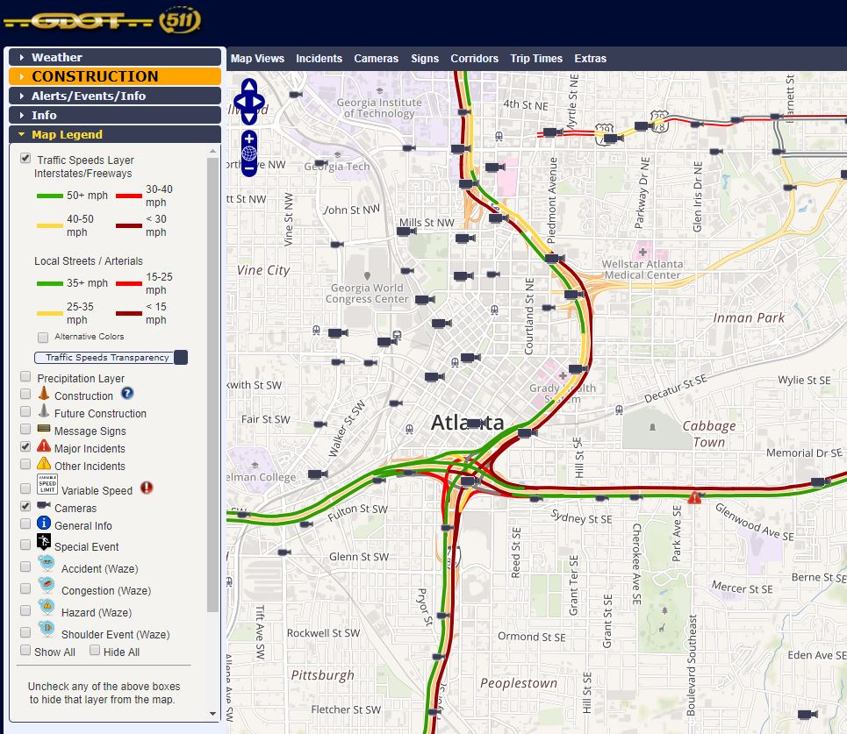

Interesting OSINT: Remote Traffic Cameras
Traffic Cameras:
Available in most
Major Cities
Notes:
Remote cameras – OSINT uses. Traffic avoidance. Vehicle Surveillance. Missing Person/Amber Alerts

Slide 56


Interesting OSINT: Remote Camera Collection
Github Collection: https://github.com/baywolf88/SeeAllTheThings
Notes:
Remote cameras

Slide 57
So what can we do to make it more challenging for people to use our data against us?

Slide 58

How Do You Protect Yourself?
The internet presents us with personal risk-based decisions
You decide what your tolerance for security versus sharing is
Consider starting restrictive and moving to permissive (nothing ever leaves the internet)
https://www.joinhoney.com/privacy

Slide 59

Opt-Out from People Search Sites
OptOutDoc
https://the.osint.ninja/optoutdoc
It helps you remove your data from public searches
Unfortunately, the data is most likely still in the systems

Slide 60

Educate Others About Sharing Your Data
Discuss your data-sharing wishes with those who may share data about you
Socialize your intentions with people you have influence over (kids)
Your family and friends' risk-based decisions impact you
Notes:
https://twitter.com/dont_share/status/431743229742960640

Slide 61
Consider Not Tying Your Accounts Together
What sometimes makes OSINT challenging is finding the right user account
When people connect their accounts, it greatly simplifies our work
Consider publicly disconnecting your various accounts
?

Slide 62

SEC487: Open-Source Intelligence Gathering and Analysis
https://www.sec487.info
6 days, 36 CPEs
Over 20 hands-on labs
Geared towards everyone: beginner to expert
Beta in Tysons Corner, Virginia, March 19-24

